Slide 1
This Training is being Recorded.
Please feel free to ask questions as they come up, but we will have Chat Box Check-Ins throughout the training.
LIVE TRANSCRIPTION IS AVAILABLE
Link for Recordings and Power Points – https://www.maine.gov/doe/learning/specialed/pl
This Photo by Unknown Author is licensed under CC BY-SA-NC
Notes:
DROP NAME/DISTRICT/ ROLE IN CHAT; LINKS FOR PM AND MUSER ARE IN CHAT BOX; BOTTOM OF SLIDE INCLUDES LINK TO PREVIOUS TRAININGS THAT ARE RECORDED AND THEIR PP

Slide 2
Advance Written Notice & Written Notice
Maine DOE
Office of Special Services and Inclusive Education
Supervision, Monitoring, and Support Team
Updated 1/3/2024

Slide 3
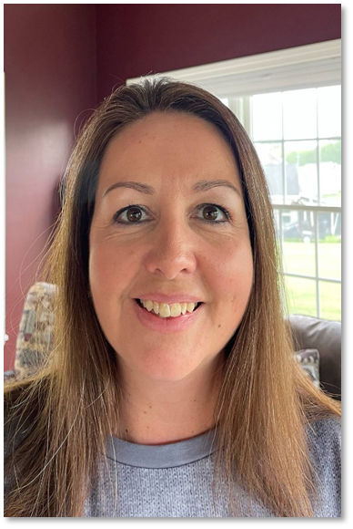
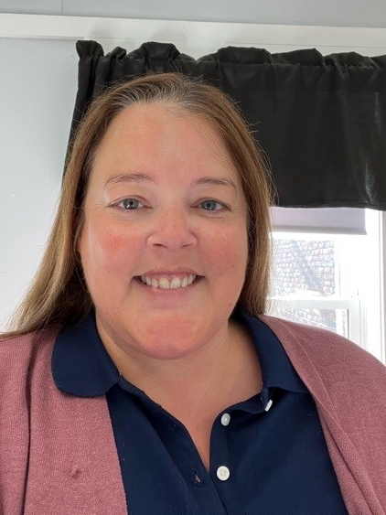
Colette Sullivan
Federal Programs Coordinator
Jennifer Gleason
Special Education Consultant
Karlie Thibodeau
Special Education Consultant
Ashley Satre
Special Education Consultant
Julie Pelletier
Secretary Associate

Slide 4
Colette Sullivan – Federal Programs Coordinator
colette.sullivan@maine.gov
Jennifer Gleason– Special Education Consultant
jennifer.gleason@maine.gov
Karlie Thibodeau– Special Education Consultant
karlie.l.thibodeau@maine.gov
Ashley Satre– Special Education Consultant
ashley.satre@maine.gov
Julie Pelletier – Secretary Associate
julie.pelletier@maine.gov

Slide 5
Agenda
Introductions
Advance Written Notice
Written Notice
Importance in Case Law
Commonly Asked Questions
Questions
Resources
This Photo by Unknown Author is licensed under CC BY-SA-NC

Slide 6
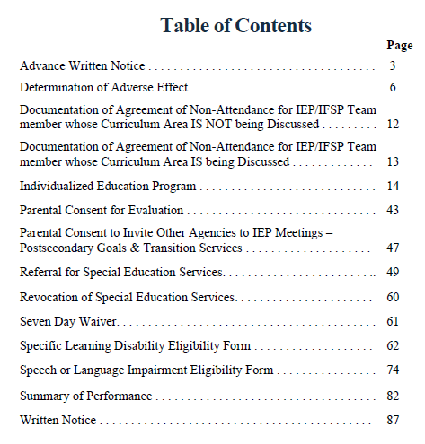
Procedural Manual-Advance Written Notice

Slide 7
Advance Written Notice
The AWN is used to provide notice to parties of an upcoming IEP/IFSP Team meeting.
This Photo by Unknown Author is licensed under CC BY

Slide 8
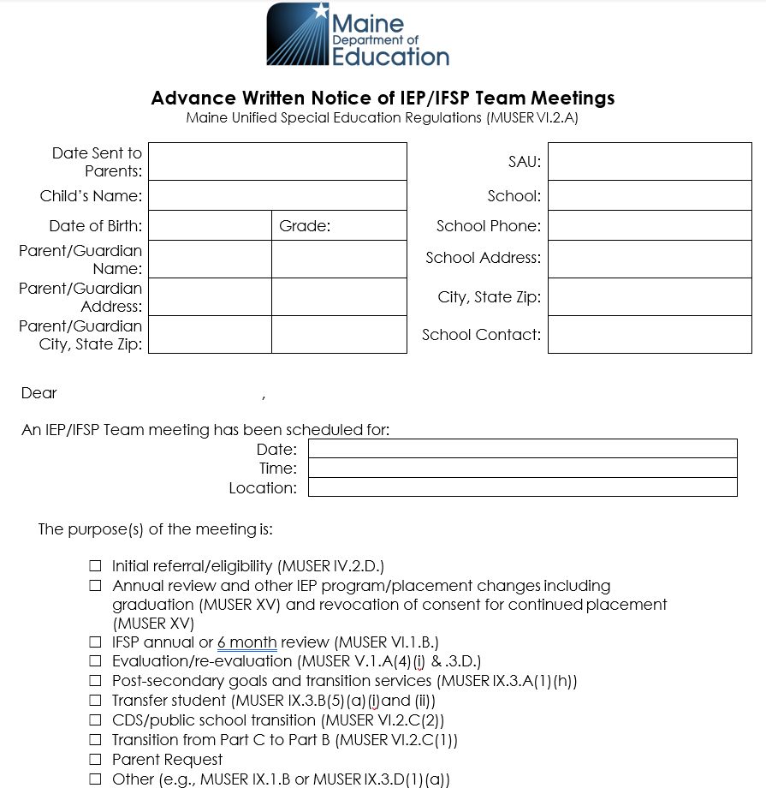
Advance Written Notice
This section is used to:
Document child specific information.
Document date, time and location of the IEP meeting.
Identify the purpose of the meeting.
Directions:
At least one box must be checked but include all that are relevant.
“Other” could include Ch 33 review, manifestation determination or similar.
If child is of transition age (9th grade or 16 or older), invite them and include name in salutation.

Slide 9
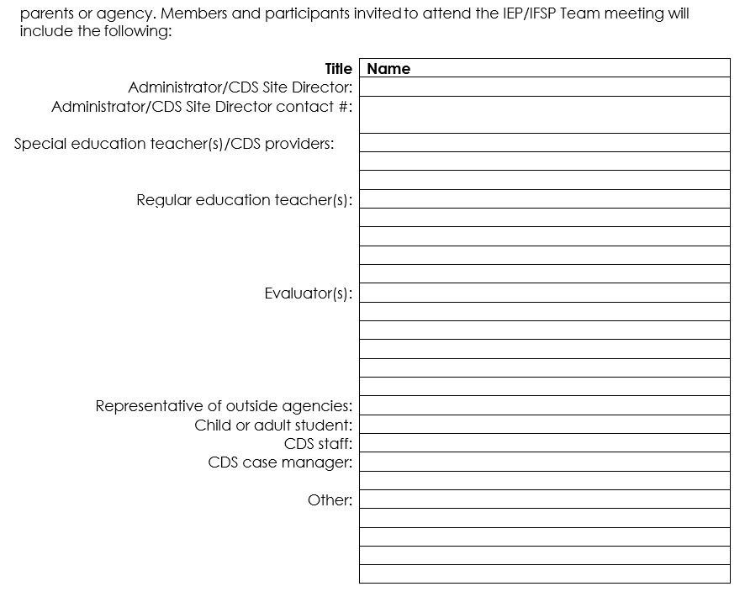
Advance Written Notice
This section is used to:
Identify the participants who are invited to the IEP meeting.
Directions:
Attendees should be identified by name and role.

Slide 10
Advance Written Notice
This section is used to:
Document the SAUs attempt to promote parent(s) participation and attendance.
Directions:
Schools must make reasonable efforts to schedule the IEP meeting at a mutually agreed on time and place.
As a rule of thumb, if the SAU is having difficulty convincing a parent to attend, it should make multiple attempts in addition to sending the AWN to schedule the IEP meeting so that parents have an opportunity to attend.
If the SAU makes these attempts and the parents do not attend, the SAU may proceed to hold the IEP meeting.

Slide 11
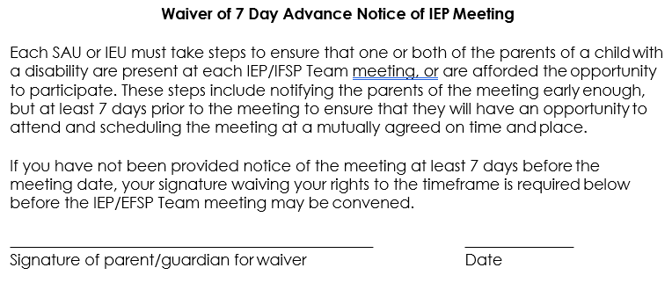
Advance Written Notice
This section is used to:
Document the parent’s willingness to waive the 7-day notice of the IEP meeting.

Slide 12
Advance Written Notice
This section is used to:
Identify any enclosures, if any, included in the AWN.
Directions:
If Procedural Safeguards, evaluation reports or other items are enclosed with AWN, record that information here.

Slide 13
Advance Written Notice
There should be alignment between the Advanced Written Notice and the Written Notice itself, because that AWN clarifies for the parent why the team is meeting.
However, if the team discusses OTHER information during that team meeting, and it makes sense to document that on the WN as well, then that is fine.

Slide 14
Chat Box Check In

Slide 15
Let’s talk about the Written Notice

Slide 16
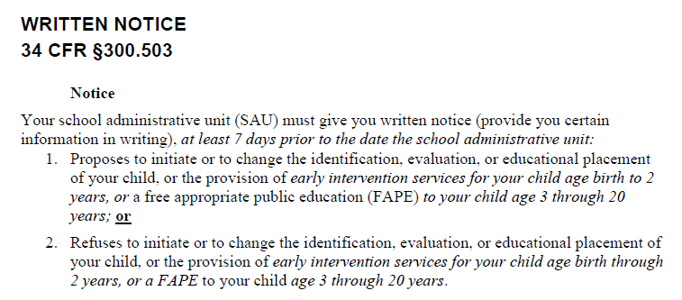
Written Notice (MUSER) Appendix 1, 34 CFR §300.503 page 220
Maine State Requirements – Italicized
Federal Statutory or Regulatory Requirements – Not Italicized

Slide 17
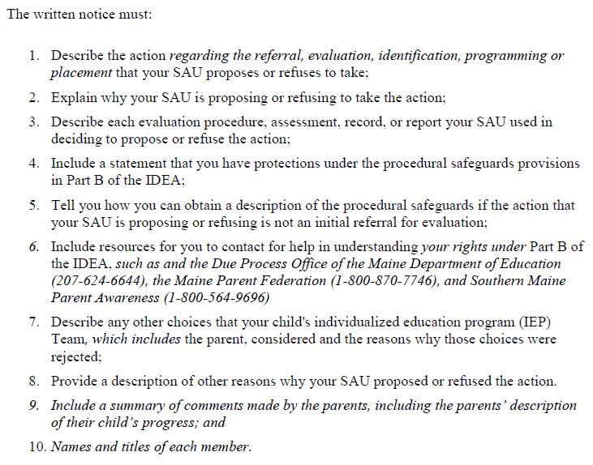
Procedural Safeguards 34 CFR §300.504

Slide 18
Written Notice
The WN is based on Federal Law from Individuals with Disabilities Education Act (IDEA).
“You” refers to the parent(s).
The WN allows parents to review decisions before implementation of the IEP, and potentially change their mind.
Courts and hearing officers view the Written Notice as a critical document that provides a written record of how and why decisions are made.

Slide 19
Written Notice
The federal regulations require that this notice be provided to the parent in a “reasonable time” before any actions are implemented.
Maine Unified Special Education Regulations (MUSER) require that this notice be provided at least 7 days prior to implementation of any proposed or refused changes.

Slide 20
Written Notice
This form is used to meet the requirements to notify parents at least 7 days prior to the date upon which the SAU takes any proposed action or refuses to act with regard to:
referral
evaluation
identification
programming
placement
informed consent for initial placement of services
provision of early intervention services or free appropriate public education to a child

Slide 21
Written Notice: Timeline Consideration
This Photo by Unknown Author is licensed under CC BY-NC
Notes:
Only for recording determinations, must be specific, including refusals to do something that the parents are requesting. If parents join consensus to not provide something, after discussion during the meeting, it does not need to be recorded. If they continue to request something that the school is refusing to do, it needs to be recorded here. Decisions during the meeting do not need full consensus, the SAU makes the final decision. Need to record when the action is to start.
Reference eligibility form used.
Decisions during the meeting should reflect progress towards closing the GAP.

Slide 22
Duration of the IEP
3(+) days (guidance)
7 days
Annual
Meeting
Date
1/6/23
Parents have the WN in their hands
1/9/23
Duration of the IEP
1/16/23
Parents have right to 7-day notice (WN)
Parent(s) must have the WN 7 calendar days prior to effective date
3 days for mail
Notes:
Annual – 10/5/18
Effective Date 10/15/2018
Parents WN – 10/8/2018

Slide 23
Written Notice: Timeline Consideration
Parent(s) can waive their right to 7-day notice
Implement IEP sooner than 7 days
7 Day Waiver form (optional)
Must be documented in the Written Notice

Slide 24
When can a parent/guardian NOT waive their 7-day notice?

Slide 25
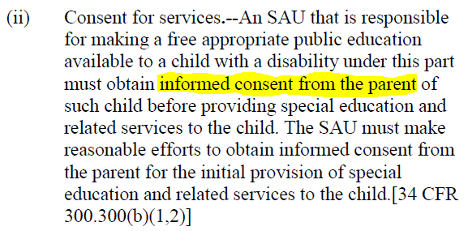
Parents cannot waive their 7-day notice if:
they do not attend the meeting

Slide 26
So…
This Photo by Unknown Author is licensed under CC BY

Slide 27
What if you hold the meeting, but the parent/guardian is not in attendance?
This Photo by Unknown Author is licensed under CC BY-NC

Slide 28
Can you call them later and share with them the details of the meeting?
This Photo by Unknown Author is licensed under CC BY

Slide 29
Consider the following:
If you contact the parent/guardian after the meeting, you are getting input from them after the fact.
This would most likely change the outcome of the meeting.
You would need to write an amendment to the IEP and complete a new Written Notice to capture this conversation.

Slide 30
Chat Box Check In
This Photo by Unknown Author is licensed under CC BY-NC-ND

Slide 31
Templates and Exemplars
*The templates and exemplars within the PowerPoint are guidance, and only examples of what could be in each section

Slide 32
Procedural Manual – Written Notice

Slide 33
Written Notice
The WN describes the Team decisions, including any that were proposed and/or rejected, any data that supports those decisions and the district’s offer of FAPE for the child.
A Written Notice must be generated and sent to a parent after every IEP/IFSP meeting, agreement with parent to amend the IEP/IFSP without a meeting, or any other time that the SAU makes any decisions that affect FAPE or Early Intervention Services. This includes an SAU decision to not convene an IEP meeting. Procedural Manual p. 87

Slide 34
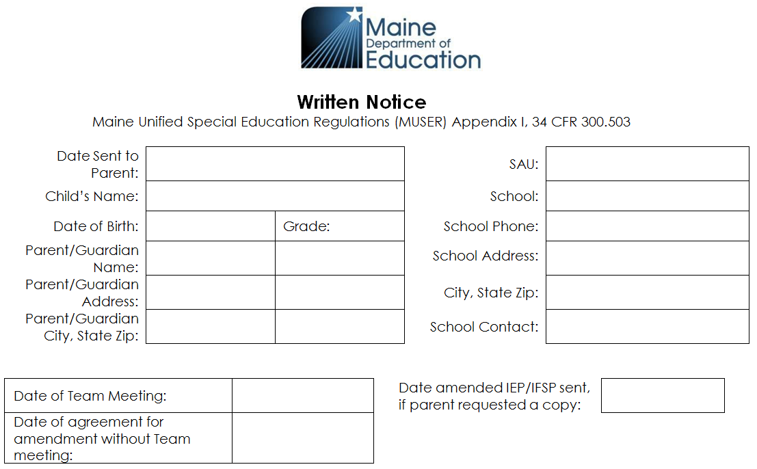
Written Notice
This section is used to:
Document pertinent child-related information.
Indicate relevant dates.
Directions:
You must enter date of IEP Team meeting OR the date of agreement for amendment without Team meeting.
If parent requested a copy of the amended IEP/IFSP enter date sent to parent.
Remember to Date
Remember to Date
Notes:
PARENT GUARDIAN INFORMATION: Space for both parents as needed and approved.

Slide 35
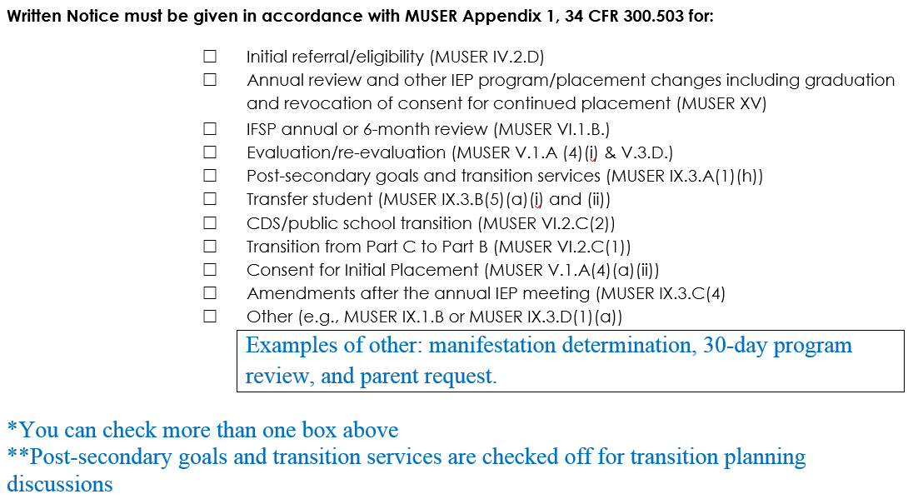
Written Notice: Purpose of the Meeting
This section is used to:
Indicate the purpose of the meeting.

Slide 36
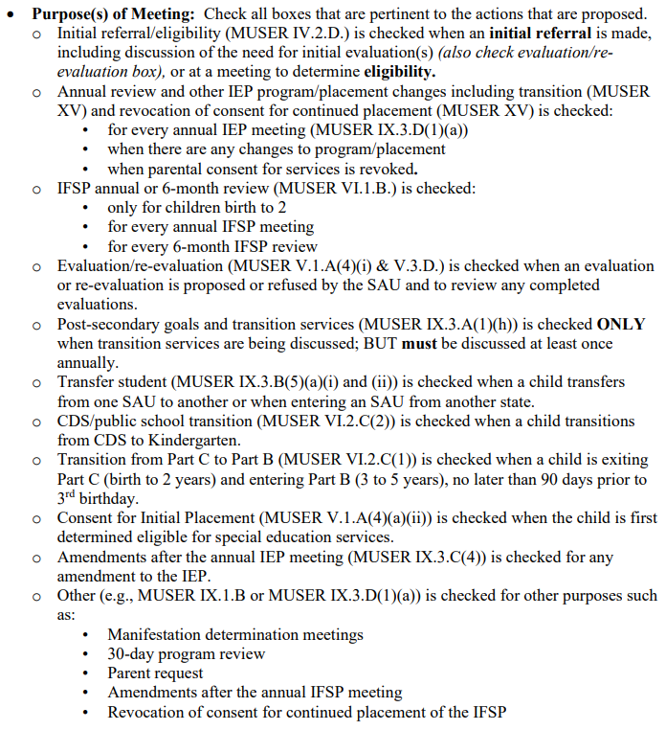
Written Notice: Purpose of the Meeting
Directions:
Notes:
At least one box should be checked. See reminder about ESY at the bottom of page 1.
*Transfer student is for students transferring from out of state or SAU to SAU, a written notice would be generated when the receiving SAU develops, adopts the current IEP or implements a new IEP reflecting the receiving SAUs provision of FAPE. Transition box needs to be checked if discussed

Slide 37
Section 1
This section is used to:
Describe the action(s) regarding the referral, evaluation, identification, programming or placement proposed or refused by the SAU.
This Photo by Unknown Author is licensed under CC BY-NC
Notes:
DATE SENT TO PARENT: The parents need to receive the Written Notice 7 days before implementation of proposed changes or refusals. The parent can agree sooner than the 7 days which would be recorded in section 1 of the form.
PARENT GUARDIAN INFORMATION: Space for both parents as needed and approved.

Slide 38
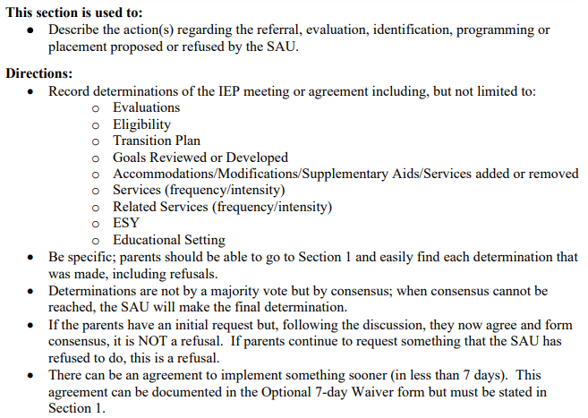
Section 1
Directions:
Procedural Manual pg. 90
Notes:
At least one box should be checked. See reminder about ESY at the bottom of page 1.
*Transfer student is for students transferring from out of state or SAU to SAU, a written notice would be generated when the receiving SAU develops, adopts the current IEP or implements a new IEP reflecting the receiving SAUs provision of FAPE. Transition box needs to be checked if discussed

Slide 39
Section 1
1. Describe the action(s) regarding the referral, evaluation, identification, programming or placement proposed or refused by the SAU:
List the proposal(s) or refusal(s) separately in specific terms. What they are and the date that they will start, not WHY, that explanation is in 2.
This Photo by Unknown Author is licensed under CC BY-NC-ND

Slide 40
Section 1
These proposal(s) or refusal(s) may include:
Referral of a child for a special education evaluation
Eligibility decisions reached about a special education evaluation using an eligibility form(s)
Agreements reached with parents without a meeting
After an IEP meeting to reflect decisions such as special education and related services, LRE, goals developed, ESY, accommodations (+/-), modifications, and supplementary aids
Transition planning, if appropriate
Determination of when to start the IEP based on parent involvement and approval

Slide 41
Section 1: Important Points
Be specific, parents should be able to go to Section 1 and easily find each determination that was made.
Determinations are made by consensus not majority. If consensus is not reached, the SAU will make the final decision.
The purpose is not necessary to discuss here, as a box on the front page indicated that purpose.
If the parent (not the Team) agrees to waive their 7-day notice, it needs to be stated here.
This Photo by Unknown Author is licensed under CC BY-SA
Notes:
Alignment between disability, needs, goals and special education services.

Slide 42
Written Notice: Section 1 Template

Slide 43
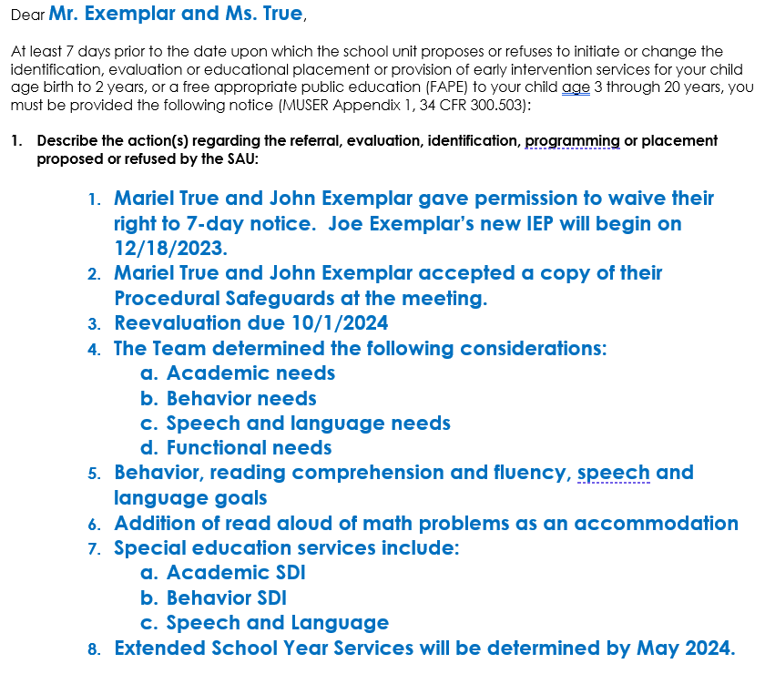
Written Notice: Section 1 Exemplar
This Photo by Unknown Author is licensed under CC BY-NC

Slide 44
Section 2
This section is used to:
Explain why the SAU is proposing or refusing the above action(s).
Directions:
For each determination in Section 1, there must be a specific and detailed corresponding explanation in Section 2. The reader should be able to clearly understand each proposal or refusal.
Notes:
DATE SENT TO PARENT: The parents need to receive the Written Notice 7 days before implementation of proposed changes or refusals. The parent can agree sooner than the 7 days which would be recorded in section 1 of the form.
PARENT GUARDIAN INFORMATION: Space for both parents as needed and approved.

Slide 45
Section 2
2. Explain why the SAU is proposing or refusing to take the above action(s):
For each proposal or refusal in Section #1 individually outline WHY the team decided on the action. This should include data and evidence.
If services are not changing for the child, you still need to record WHY that proposal or refusal was made.
This should be written in a way that the parent(s) can understand.
This Photo by Unknown Author is licensed under CC BY-SA-NC

Slide 46
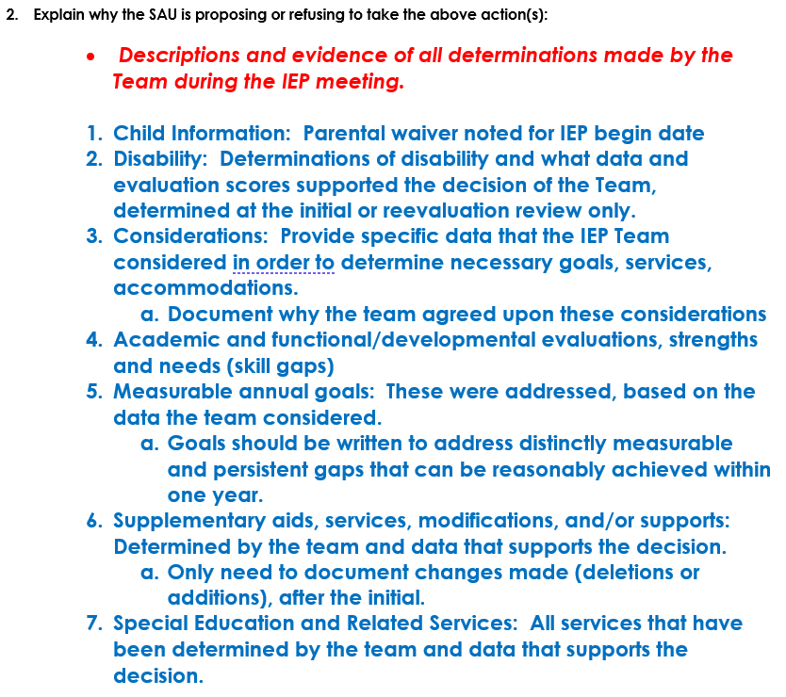
Written Notice: Section 2 Template

Slide 47
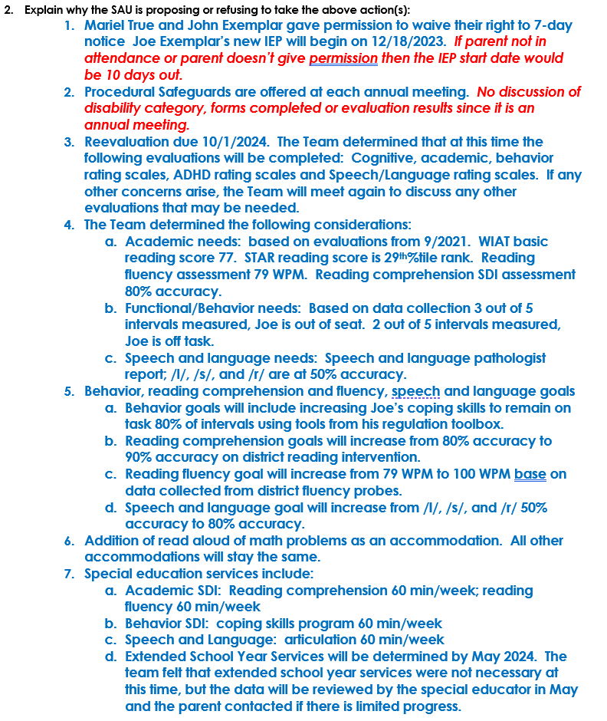
Written Notice: Section 2 Exemplar
This Photo by Unknown Author is licensed under CC BY-NC

Slide 48
Questions – Comments
This Photo by Unknown Author is licensed under CC BY-NC

Slide 49
Section 3
This section is used to:
Describe each evaluation procedure, assessment, record or report the SAU used as a basis for the proposed or refused action(s).
Directions:
Evaluations: name, date, scores. Also, assessments (state, local, curriculum), observations, parent/teacher reports, clinical opinions, progress reports or similar, related service provider report(s). However, evaluation reports do not need to be included if eligibility is not being determined at the meeting.
This Photo by Unknown Author is licensed under CC BY-SA
Notes:
DATE SENT TO PARENT: The parents need to receive the Written Notice 7 days before implementation of proposed changes or refusals. The parent can agree sooner than the 7 days which would be recorded in section 1 of the form.
PARENT GUARDIAN INFORMATION: Space for both parents as needed and approved.

Slide 50
Section 3
3. Describe each evaluation procedure, assessment, record or report the SAU used as a basis for the proposed or refused action(s):
Record all information used by the team at the meeting to make determinations and support programming based on eligibility of the child
Documenting introductions of Team members and a confidentiality statement made at the meeting, is recommended
Evaluations – the description of the evaluation procedure considered by the IEP team must include names and dates of the evaluations considered, the subtests that were considered and the scores
Notes:
Should record relevant scores and assessments to make the determination, not all or out of date scores/assessments.
Teacher and parent reports should be specific to proposed and refused actions.

Slide 51
Written Notice: Section 3 Template

Slide 52
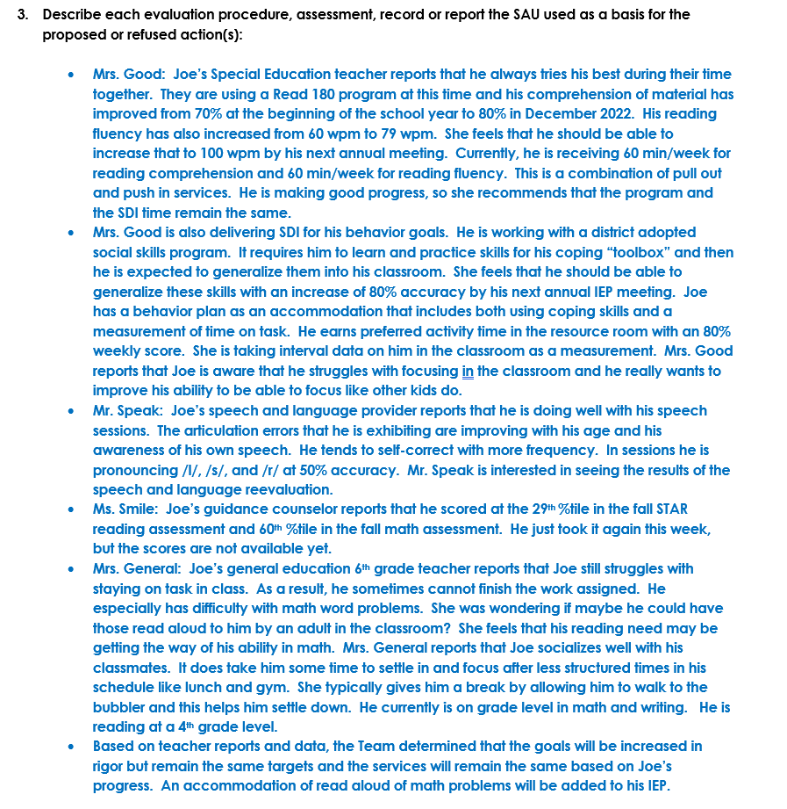
Written Notice: Section 3 Exemplar
This Photo by Unknown Author is licensed under CC BY-SA-NC

Slide 53
Section 4
This section is used to:
Describe any other options that the Team, which includes the parent, considered and the reasons why those options were rejected.
Directions:
In reviewing the determinations in Section 1, document other alternative options that were available/presented to the team and not chosen, such as LRE options, continue or change program, eligibility criterion, ESY or similar.
This Photo by Unknown Author is licensed under CC BY-NC
Notes:
DATE SENT TO PARENT: The parents need to receive the Written Notice 7 days before implementation of proposed changes or refusals. The parent can agree sooner than the 7 days which would be recorded in section 1 of the form.
PARENT GUARDIAN INFORMATION: Space for both parents as needed and approved.

Slide 54
Section 4
4. Describe any other options that the Team, which includes the parent, considered and the reasons why those options were rejected:
Continue present program vs. change in program
Discussions around more than one eligibility criterion
ESY (yes/no) – amount of ESY
LRE options that were not chosen (general vs. special education)

Slide 55
Section 5
This section is used to:
Describe any other factors that are relevant to the SAU’s proposed or refused action(s) described above.
Directions:
Include other factors that impact educational programming, such as, medication or other health conditions, change in residence, ELL learners, family related factors, attendance or similar.
This Photo by Unknown Author is licensed under CC BY
Notes:
DATE SENT TO PARENT: The parents need to receive the Written Notice 7 days before implementation of proposed changes or refusals. The parent can agree sooner than the 7 days which would be recorded in section 1 of the form.
PARENT GUARDIAN INFORMATION: Space for both parents as needed and approved.

Slide 56
Section 6
This section is used to:
Describe the points made by the parent including their description of their child’s progress. It is also intended to provide the name, title and phone number of the person(s) or agencies to contact to obtain a copy of the Procedural Safeguards or assistance around them.
Directions:
Input from parent prior to a meeting can be included. If parent did not attend, and did not provide input, you could document that here.
Notes:
DATE SENT TO PARENT: The parents need to receive the Written Notice 7 days before implementation of proposed changes or refusals. The parent can agree sooner than the 7 days which would be recorded in section 1 of the form.
PARENT GUARDIAN INFORMATION: Space for both parents as needed and approved.

Slide 57
Written Notice: Section 6
6. Description of the points made by the parent including the parent’s description of their child’s progress:
- Points made by parent(s) go here. This will ensure that what was recorded and determined is reflective of the parent(s) wishes.
- These should align, not mirror section #3A in the IEP.
Section 3A - Ensure the parental concerns align with the concerns in Section 6 of the Written Notice (WN)
Notes:
Some overlap with section 3. More in depth parent concerns should be here versus section 3. Make sure to review the procedural safe guards below section 6 and in general.

Slide 58
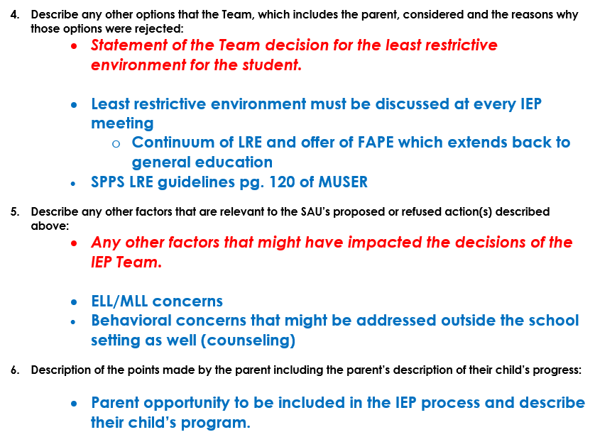
Written Notice: Section 4, 5 and 6 Template

Slide 59
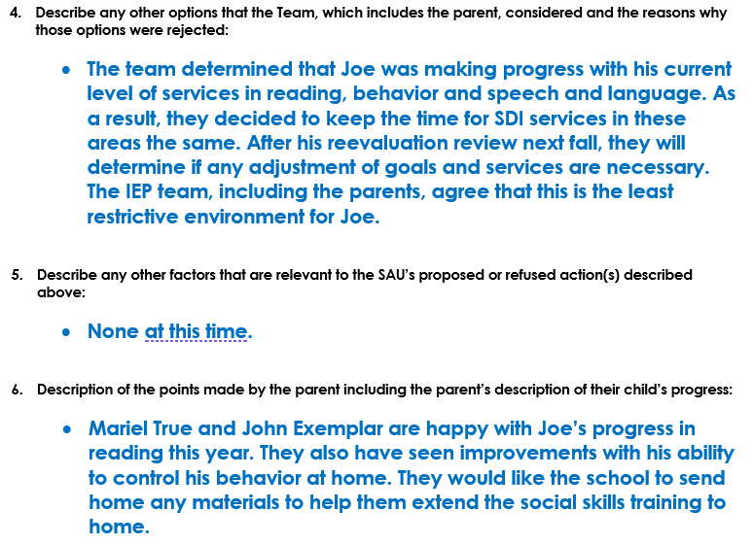
Written Notice: Section # 4, 5 and 6 Exemplar
This Photo by Unknown Author is licensed under CC BY-SA

Slide 60
Procedural Safeguards
https://www.maine.gov/doe/CDS/ProceduralSafeguards

Slide 61
Written Notice
No section(s) of the Written Notice can be left blank. Instead, at least write…
None at this time
Not applicable
Etc.
This Photo by Unknown Author is licensed under CC BY-SA-NC

Slide 62
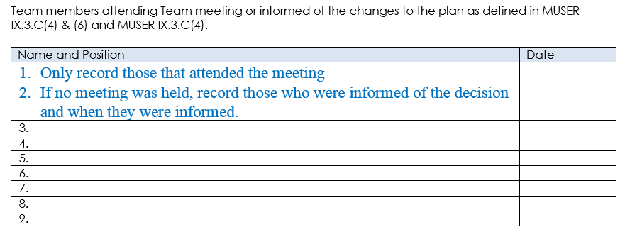
Written Notice – Members Attended
This Photo by Unknown Author is licensed under CC BY-NC

Slide 63
Initial Provision of Service
This Photo by Unknown Author is licensed under CC BY-SA

Slide 64
Enclosures
Could include:
Parental Consent to Evaluate
Procedural Safeguards
Eligibility forms

Slide 65
This Photo by Unknown Author is licensed under CC BY

Slide 66
If it’s not in the Written Notice, it didn’t happen.
Remember…

Slide 67
The U.S. Supreme Court’s ruling in Endrew vs. Douglas County School District, highlighted the fact that IEP teams must discuss and develop IEP goals for students that are “appropriately ambitious” and that “to met its substantive obligation under the IDEA, a school must offer an IEP that is reasonably calculated to enable a child to make progress appropriate in light of the child’s circumstances.”

Slide 68
Therefore, it is important to remember -
“IEP teams must demonstrate the following indicators of progress:
The child is receiving all special education, supplementary aids, and related services outlined in the IEP
The IEP team is making appropriate modifications as required
School personnel receive the supports and professional development they need
Appropriate accommodations are provided
Measurable IEP goals enable a clear assessment of whether the child is making adequate progress.”
https://www.smartersteps.com/2018/11/28/endrew-decision-
how-do-you-write-ambitious-iep-goals/

Slide 69
Written Notice Importance in Case Law
Some common mistakes:
The Written Notice failed to document the team discussion about the child’s current lack of progress (either there was no data available, the discussion never happened, or the discussion happened and wasn’t documented in the WN).
The lack of progress discussion should prompt the IEP team to look at goals, accommodations/modifications and services, what isn’t working, what needs to be done differently etc.
The discussion and changes should be documented in the written notice in detail

Slide 70
Written Notice Importance in Case Law
Some common mistakes:
This Photo by Unknown Author is licensed under CC BY-SA
The Written Notice indicates a change of Least Restrictive Environment without indication of the parents' disagreement/agreement to the changes
LRE change happens without 7-day notice
The District needs to indicate in the Written Notice the disagreement/agreement discussion and why the IEP team made the LRE change.

Slide 71
If it’s not in the Written Notice, it didn’t happen.
Don’t forget…

Slide 72
Commonly Asked Questions –
This Photo by Unknown Author is licensed under CC BY-NC

Slide 73
Do the words “Least Restrictive Environment”
need to appear in the Written Notice?
No, we do not look for that level of specificity, but if your director wants that documented, feel free to include it. However, there does need to be clear documentation that LRE for the child was discussed at every IEP Team Meeting.

Slide 74
Where should the conversation of COVID-19 be documented in the Written Notice?
The impact of COVID-19 should be noted in the WN in a way that best documents the team discussion. It can be noted in Section 3, 4 or 5, and could be included in Section 6 if there are Parent Concerns.

Slide 75
What if the parent waives their right to 7-day notice?
Only the parent can waive this right, and it needs to be documented in the WN that “the parent waived their right”. It is not a team decision.

Slide 76
Questions?
This Photo by Unknown Author is licensed under CC BY

Slide 77
Resources
Procedural Manual

Slide 78
Resources
Procedural Manual
Maine Unified Special Education Regulations (MUSER)

Slide 79
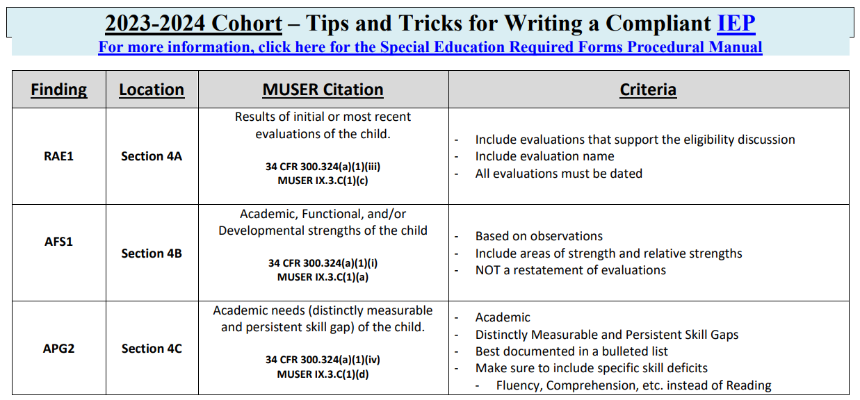
Resources
Procedural Manual
Maine Unified Special Education Regulations (MUSER)
2023-24 Cohort IEP Quick Reference Document

Slide 80
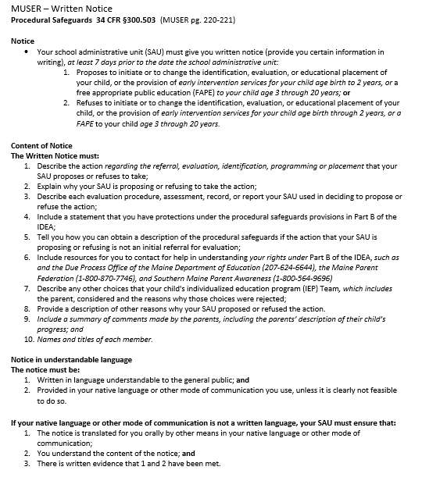
Resources
Written Notice Fun Facts
Maine Unified Special Education Regulations (MUSER)
2023-24 Cohort IEP Quick Reference Document

Slide 81
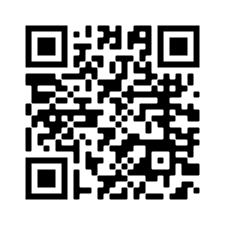
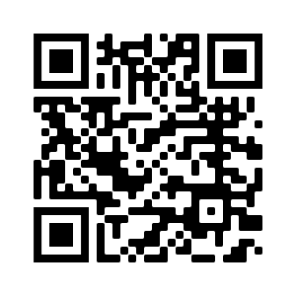
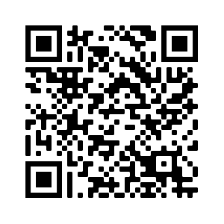
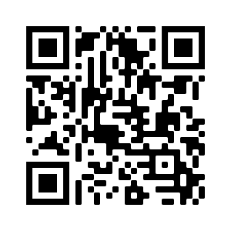
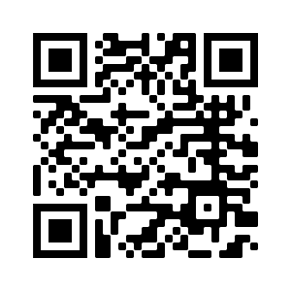
Resources
Written Notice Fun Facts
Professional Development Calendar
Link for Recordings and Power Points
Special Education Resources
Special Education Laws and Regulations
Special Education Forms and Reporting
2023-24 Cohort IEP Quick Reference Document

Slide 82
Resources
Written Notice Fun Facts
Professional Development Calendar
Link for Recordings and Power Points
Special Education Resources
Special Education Laws and Regulations
Special Education Forms and Reporting

Slide 83
2023-24 Professional Development Schedule
DATE | TOPIC/DESCRIPTION | REGISTRATION LINK
Wednesday 9/13/23 | Resources | Resources Registration Link
Wednesday 9/27/23 | Transition from CDS to Public School | Transition from CDS to Public School Registration Link
Friday 9/29/23 | Q&A Session | Q & A Registration Link
Wednesday 10/11/23 | Abbreviated Day | Abbreviated Day Registration Link
Tuesday 10/24/23 | Fall All District IEP Training | IEP Training Registration Link (10/24/23)
Tuesday 10/24/23 | Fall All District B-13 Training | B-13 Training Registration Link (10/24/23)
Wednesday 10/25/23 | Discipline & Manifestation Determination | Discipline & Manifestation Determination Registration Link
Friday 10/27/23 | Q&A Session | Q & A Registration Link
*Wednesday 11/8/23* | *Alignment and DIB1 (Disability Alignment)* | Alignment and DIB1 Registration Link
Wednesday 12/13/23 | Orientation and Mobility | Orientation and Mobility Registration Link
Wednesday 12/20/23 | Compliant Transition Plans | Compliant Transition Plans Registration Link
Tuesday 1/9/24 | Winter All District B-13 Training | B-13 Training Registration Link (1/9/24)
Tuesday 1/9/24 | Winter All District IEP Training | IEP Training Registration Link (1/9/24)
Wednesday 1/10/24 | Advanced Written Notice & Written Notice | Advanced WN and WN Registration Link

Slide 84
2023-24 Professional Development Schedule (cont.)
DATE | TOPIC/DESCRIPTION | REGISTRATION LINK
Wednesday 1/24/24 | Present Level of Performance | Present Level of Performance Registration Link
Friday 1/26/24 | Q&A Session | Q & A Registration Link
Wednesday 2/14/24 | Writing Measurable Functional Goals and Avoiding Outcomes | Writing Measurable Functional Goals Registration Link
Wednesday 2/28/24 | Transition from CDS to Public School | Transition from CDS to Public School Registration Link
*Wednesday 3/13/24* | *Least Restrictive Environment* | Least Restrictive Environment Registration Link
Wednesday 3/27/24 | Forms – (AE attached to WN) | Forms (AE attached to WN) Registration Link
Friday 3/29/24 | Q&A Session | Q & A Registration Link
Wednesday 4/10/24 | Special Education Law for General Education Teachers | Special Education Law for General Education Teachers Registration Link
Wednesday 4/24/24 | IEP Essentials | IEP Essentials Registration Link
Friday 4/26/24 | Q&A Session | Q & A Registration Link
Thursday 5/2/24 | Spring All District IEP Training | IEP Training Registration Link (5/2/24)
Thursday 5/2/24 | Spring All District B-13 Training | B-13 Training Registration Link (5/2/24)
Wednesday 5/8/24 | Consultation/Related Service Goals | Consultation/Related Service Goals Registration Link
Wednesday 5/22/24 | Data Collection | Data Collection Registration Link
Friday 5/24/24 | Q&A Session | Q & A Registration Link

Slide 85
Please consider sharing the links to these PD opportunities with general education teachers:
Wednesday 10/25/23 - Discipline & Manifestation Determination
Wednesday 4/10/24 - Special Education Law for General Education Teachers
Please consider sharing the links to these PD opportunities with related service providers:
Wednesday 2/14/24 - Writing Measurable Functional Goals and Avoiding Outcomes
Wednesday 5/8/24 - Consultation/Related Service Goals

Slide 86
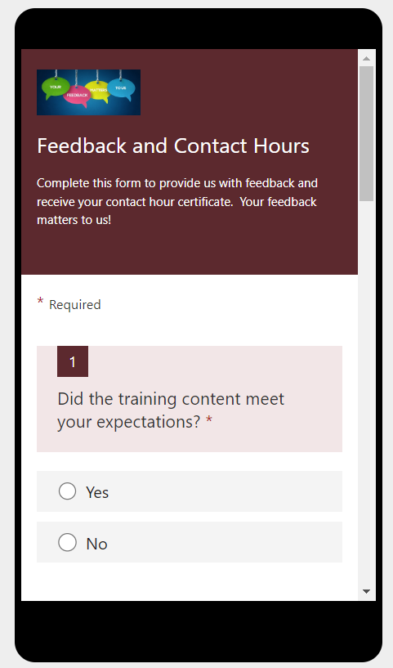
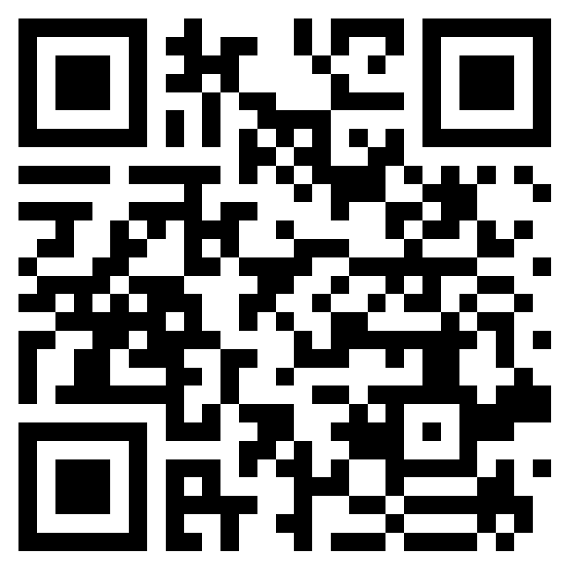
Professional Learning Feedback and Contact Hour Form
Use the link to complete the form on your computer
OR
Use the QR code to complete the form on your mobile device
https://forms.office.com/g/by472QQLDJ

Slide 87
This Photo by Unknown Author is licensed under CC BY-NC
Colette Sullivan – Federal Programs Coordinator
colette.sullivan@maine.gov
Jennifer Gleason – Special Education Consultant
jennifer.gleason@maine.gov
Karlie Thibodeau – Special Education Consultant
karlie.l.thibodeau@maine.gov
Ashley Satre – Special Education Consultant
ashley.satre@maine.gov
Julie Pelletier – Secretary Associate
julie.pelletier@maine.gov
This Photo by Unknown Author is licensed under CC BY-NC

